Slide 1

COM769 - Scalable Advanced Software Solutions
Submitted By : Joslin Gadde -20076078

Slide 2
The Problem Identified
Growing demand for short form video platforms
Existing Monolithic architecture-based applications facing due to concurrent millions of video streaming (Kader et al., 2025).
Trouble Managing Storage and Bandwidth efficiency.
Low Latency playback globally

Slide 3
Scalability Issues
High Storage demand for large video files and for quality purpose(Kumar et al., 2024)
Media Transcoding (converting them to multiple formats)
High Read and Write Operations (Upload and Views Stream)
Cost Optimization in pay as you go cloud environment

Slide 4




Technical Solution
Codebase hosted in GitHub.
CI/CD pipeline builds a Docker container for the app.
Image stored in Azure Container Registry (ACR).
Azure Web App for Containers pulls the image and runs the service.
Video data flows through:
Azure Blob Storage (video storage).
Azure Media Services (transcoding).
Azure CDN (global low-latency delivery).

Slide 5
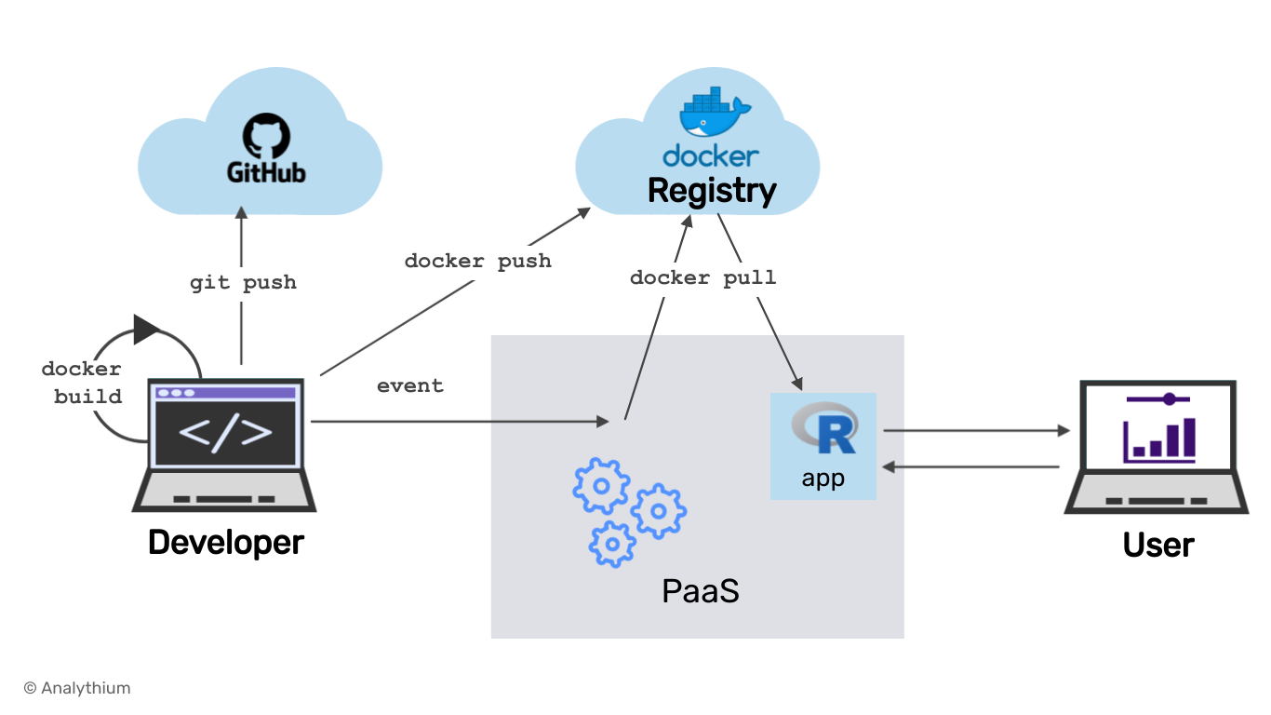
Technical Solution
Storage & Media Handling
Azure Blob Storage for scalable video storage.
Azure Media Services for video transcoding and streaming. (Babu, 2019)
Content Delivery Network (CDN) for global distribution.
Containerization advantage: video processing microservices can be packaged in Docker and scaled independently.

Slide 6
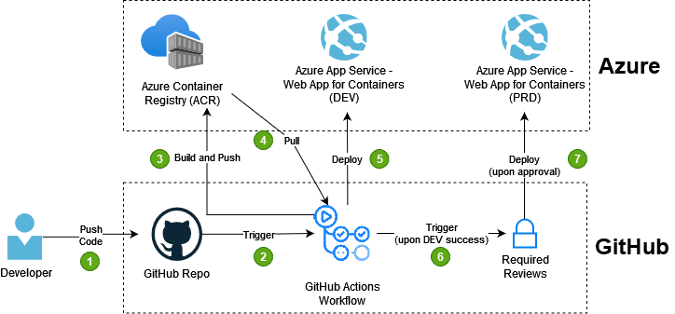
Technical Solution – Authentication and Security
HTTPS encryption for secure communication
Azure Active Directory B2C for user authentication
Role-based access for creators and consumers.
Docker containers run isolated environments, ensuring minimal attack surface.

Slide 7
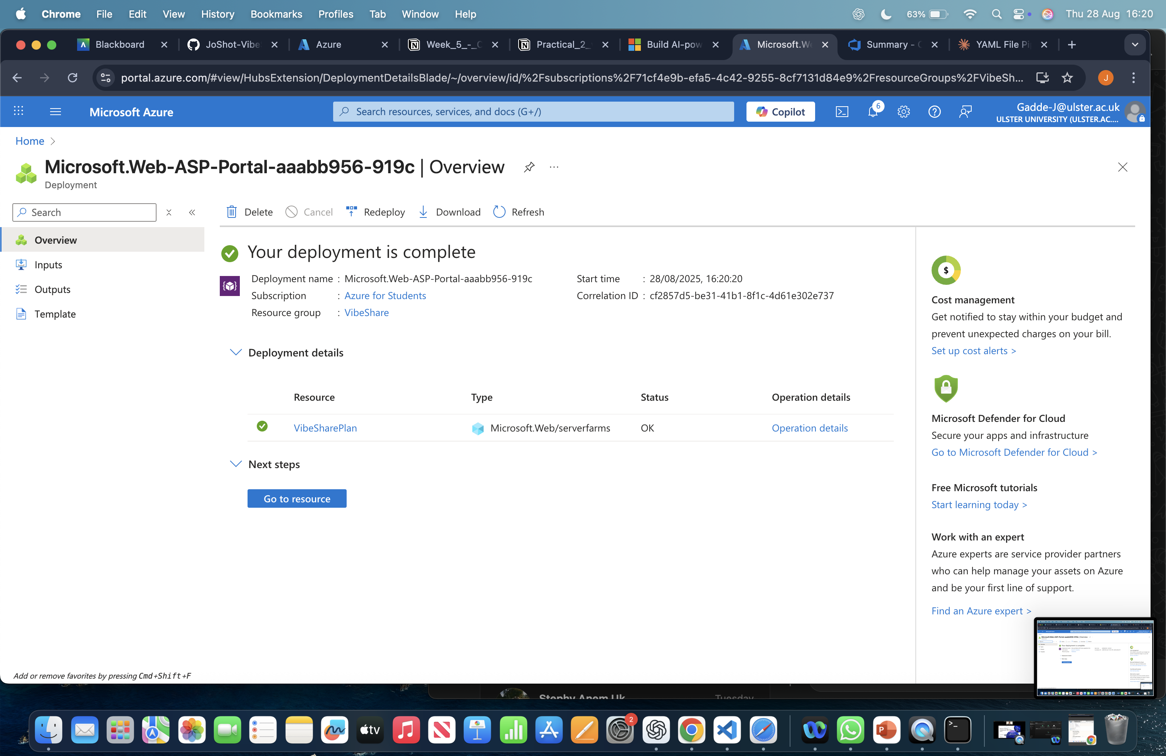
Technical Solution – Deployment ad CI/CD
Configuring CI/CD Pipeline
GitHub Actions workflow builds and tests Docker image.
Image is pushed to Azure Container Registry (ACR).
Azure Web App for Containers pulls the latest image and redeploys automatically.
Azure Monitor + Application Insights track container health and app performance.
Scalability: App Service Plan auto-scales container instances based on demand.
Resources Deployment

Slide 8
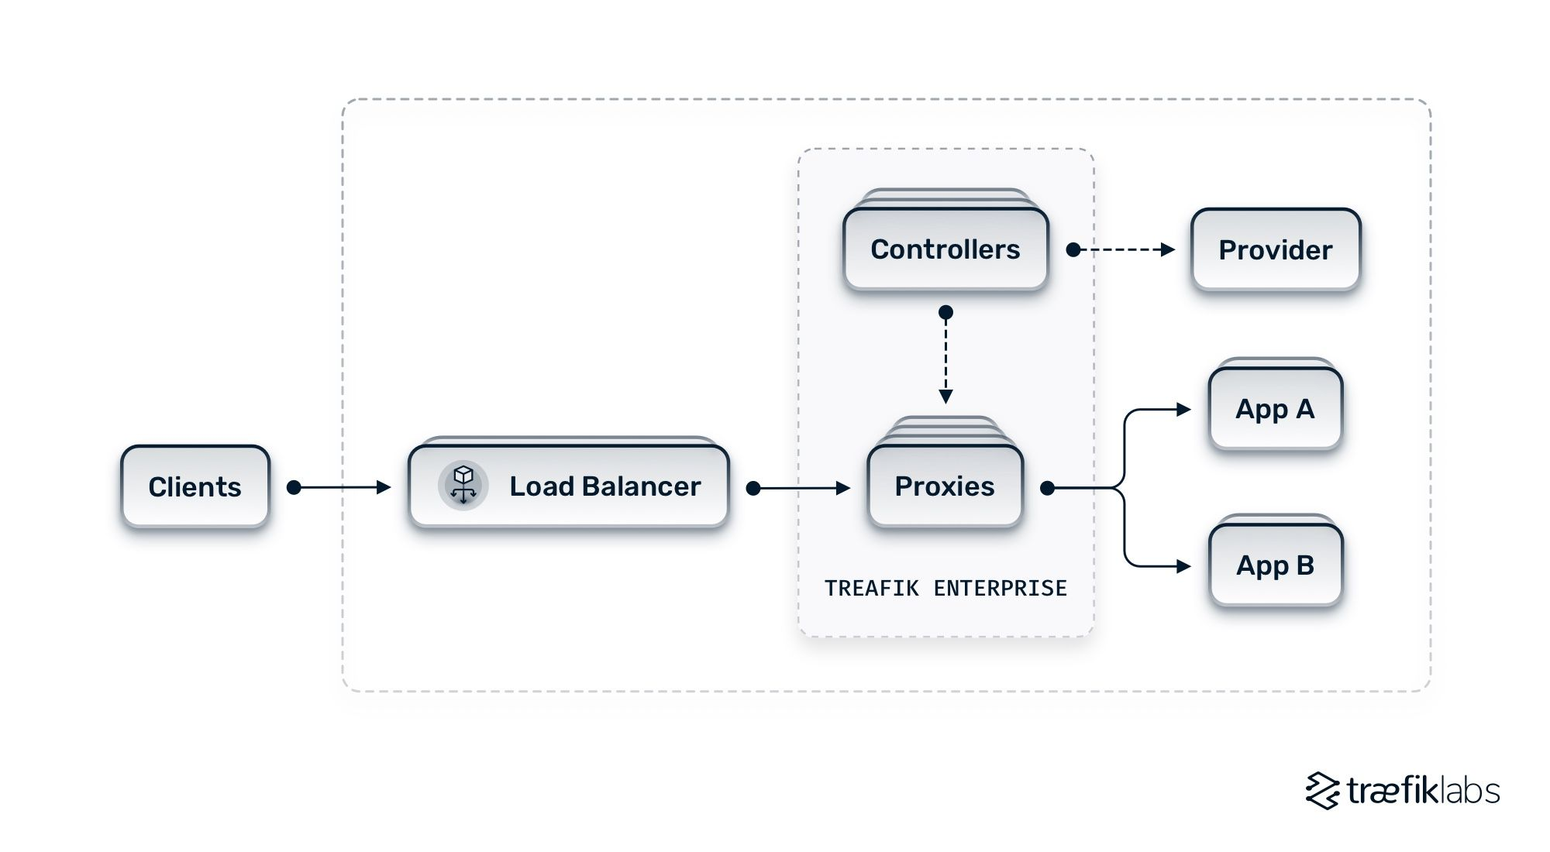
Overview of Advanced features
Containerized microservices: App runs inside Docker containers, ensuring consistency across environments.
Elastic scaling: Containers auto-scale under Azure App Service Plan (scale out to multiple instances).
Future-ready: Containers can be migrated to Azure Kubernetes Service (AKS) for large-scale orchestration.
Multi-format adaptive streaming (480p/720p/1080p) via Azure Media Services.

Slide 9
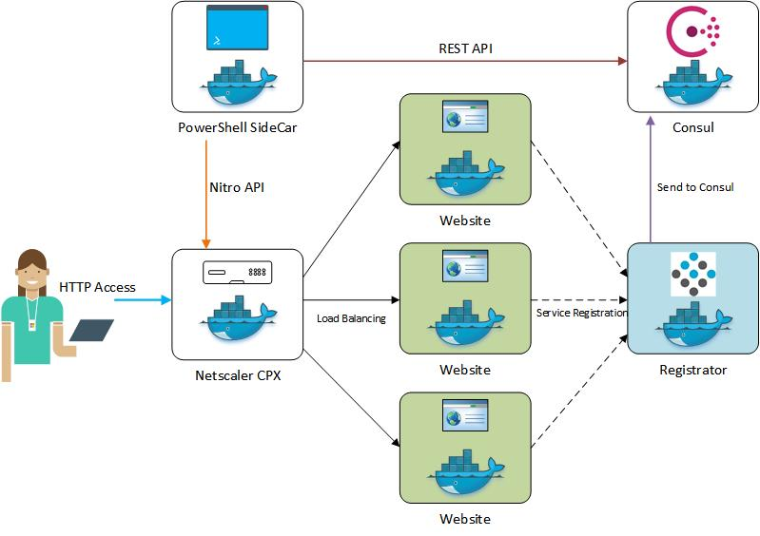
Overview of Advanced Functionalities
Interactive UI built with React.
Creator/Consumer accounts with personalized dashboards.
Social features: likes, comments, and following system.

Slide 10
Limitations
Cost of scaling storage and compute in Azure.
Dependency on internet bandwidth for video streaming.
Latency issues in regions not covered well by Azure.
Complex setup for maintaining microservices.

Slide 11
Scalability Evaluation
Horizontal Scaling: App Service Plan can scale Docker containers based on CPU/memory load.
Unlimited Storage: Azure Blob Storage is virtually limitless.
Global Distribution: CDN ensures low-latency playback worldwide.
Future Scalability: Dockerized app can migrate to AKS for millions of users.
CI/CD efficiency: Every push → Docker image build → automatic redeploy ensures rapid iteration.

Slide 12
Conclusion
Successfully built a scalable video-sharing application.
Cloud-native approach ensures flexibility, performance, and cost efficiency.
Azure ecosystem supports storage, streaming, authentication, and monitoring.
Future improvements: AI-driven recommendations & advanced analytics.
Benefits:
Scalability → horizontal scaling of container instances.
Reliability → automated deployment pipeline reduces manual errors.
Flexibility → future migration possible to Azure Kubernetes Service (AKS).
Overall, the solution demonstrates a modern, scalable, and production-ready approach to building and deploying video-sharing platforms in the cloud.

Slide 13
References
Lu, J., 2024, December. A Study of the Impact of the Rise of Short Video Platforms on the Film and Television Production Process. In 2024 4th International Conference on Social Development and Media Communication (SDMC 2024) (pp. 217-223). Atlantis Press.
Kader, J., Abir, M.A.R., Islam, S.T., Utsha, M.A.H., Shuvo, N.I., Jim, E.M. and Islam, S., 2025, February. Comparative Analysis between Monolithic and Microservice Architecture Based on Web Streaming Applications. In 2025 International Conference on Electrical, Computer and Communication Engineering (ECCE) (pp. 1-6). IEEE.
Kumar, T., Sharma, P., Tanwar, J., Alsghier, H., Bhushan, S., Alhumyani, H., Sharma, V. and Alutaibi, A.I., 2024. Cloud‐based video streaming services: Trends, challenges, and opportunities. CAAI Transactions on Intelligence Technology, 9(2), pp.265-285.
Zhang, D.Y., Badilla, J., Tong, H. and Wang, D., 2018, August. An end-to-end scalable copyright detection system for online video sharing platforms. In 2018 IEEE/ACM International Conference on Advances in Social Networks Analysis and Mining (ASONAM) (pp. 626-629). IEEE.
Babu, T.D.M., 2019. Navigating the World of Cloud Storage: AWS, Azure, and More.

Slide 14
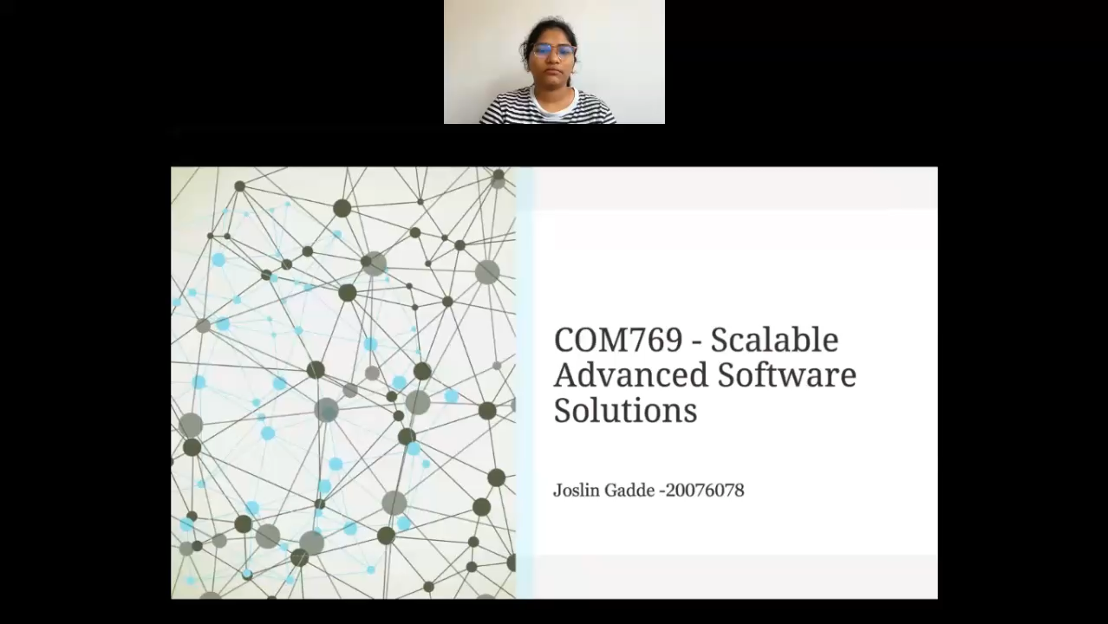
Key Features Demonstration
Points to be mentioned :
Due to Limited access on resources on student subscription , lot of functionality left unused.
Load Balancers can be used to trade off latency

